Slide 1
Time Series Analysis- Various Approaches
CKSI- AADS
Jeremy, Shovon, Vibha, Urjaswi

Slide 2
AGENDA
PI Sensor – Overview (Performance Comparison)
Overview – SVM- Regression, ANN/RNN, STL
Relevance of such state-of-the-art Models in PI Sensors
Appendix – References and Model Summary doc

Slide 3

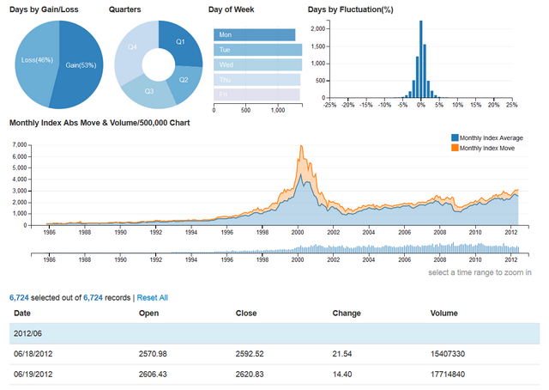

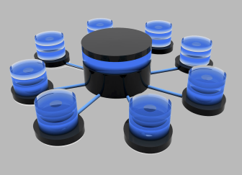
PI Sensors: Overview
Project Overview
Methodology
The world of Personal Investing is changing. There is a lot of pressure to make sure that our business is heading in the right direction.
As part of this exercise, there is an initiative to measure some of our core KPIs to get the pulse of our business in as real time manner as possible.
Measuring and understanding these KPIs will help the leadership make more reasoned and informed Decision.
The KPI that we have studied and presented here is Exiting Money-SPS and New Money SPS.
The modeling framework used here : Driver Based Time Series Forecasting.
Both Univariate and Multivariate Forecasts were used.
ANN (with different hidden layers and nodes) were used to arrive at the final forecast.
Various Univariate and Multivariate Time Series Forecasting Algo(s) were used
ESM
Theta Model
ANN – MLP
ARIMA
STL Decomposition Model
RNN
PROPHET-FB
SVM - Regression
Performance Summary
Model - Multivariate | MAPE(%)
SVM - Regression | 5%
PLS | 20%
Model - Univariate | ----
RNN/ANN | 2% / 5%
PROPHET | 8%
STL | 11%
ESM | 8%
Data Source
CWE Data
Macroeconomic Time- Series Data
Hadoop Base Data

Slide 4
Overview- Support Vector Regression (SVM - Regression)

Slide 5

Overview –Support Vector Machines - Regression
Support Vector Machine Regression
.What is SVM:
The main idea of support vector machine is to find the optimal hyperplane (line in 2D, plane in 3D and hyperplane in more than 3 dimensions) which maximizes the margin between two classes. In layman's term, it is about finding the optimal separating boundary to separate different classes.
SVM Regression:
The goal of SVM regression is same as classification problem i.e. to find maximum margin. Here, it means minimize error. In the case of regression, a margin of tolerance (epsilon) is set in approximation to the SVM. The primary goal is to minimize error, individualizing the hyperplane which maximizes the margin, keeping in mind that part of the error is tolerated. Broadly there are three different types of SVM regression – SVM eps –regression, SVM –nu regression and Bound Constraint SVM –eps Regression.
SVM – Standardization: All kernel methods are based on distance. Hence, it is required to scale our variables. If we do not standardize our variables to comparable ranges, the variable with the largest range will completely dominate in the computation of the kernel matrix. For example, we have two variables - X1 and X2. Values of variable X1 lies between 0 and 100 whereas values of X2 lies in range of 100 and 10000. In this case, variable X2 would dominate variable X1. It is recommended to standardize each variables to the range [-1.1] or [0,1]. The z-score and min-max are the two popular methods to standardize variables. Another reason of standardization is to avoid numerical difficulties during computation. Because kernel values usually depend on the inner products of feature vectors, e.g. the linear kernel and the polynomial kernel, large attribute values might cause numerical problems. Tuning Parameters of SVM: (For Linear Kernel):
There is only one parameter in linear kernel - Cost (C). It implies misclassification cost on training data.
A large C gives you low bias and high variance. Low bias because you penalize the cost of misclassification a lot. Large C makes the cost of misclassification high, thus forcing the algorithm to explain the input data stricter and potentially overfit.
A small C gives you higher bias and lower variance. Small C makes the cost of misclassification low, thus allowing more of them for the sake of wider "cushion"
The goal is to find the balance between "not too strict" and "not too loose". Cross-validation and resampling, along with grid search, are good ways to finding the best C.
Tuning Parameters of SVM: (For Non-Linear Kernel):
Two parameters for fine tuning in radial kernel - Cost and Gamma
The parameter cost is already explained above (See the 'Linear Kernel' section). Gamma explains how far the influence of a single training example reaches. When gamma is very small, the model is too constrained and cannot capture the complexity or “shape” of the data.
Support Vector Regression Tuning Parameters:
Epsilon (e)
Cost (c)
Fidelity Confidential

Slide 6


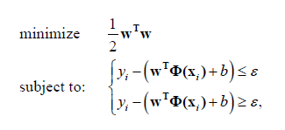
Overview –Support Vector Machines – Regression – cont.
Support Vector Machine Regression
SVM Overview:
The concept of a support vector machine (SVM) was recently developed by Vapnik and his co-workers at AT&T (Vapnik, 1995). SVM is an optimization technique that attempts to find a hyperplane in the original input space to separate a given training set correctly and leave as much distance as possible from the closest instances to the hyperplane on both sides. In regression estimation, the data points that realize the maximal margin are called support vectors. In other words, they are the data points whose approximation errors are equal to or larger than the so-called tube size of SVM. If the training set is not linearly separable, then a nonlinear boundary has to be constructed. In order to achieve the nonlinear boundary, the original input space is mapped into a higher dimensional space called feature space. The feature space is then searched for a hyperplane that can separate the instances in the same feature space. The mapping from the input space to the feature space is defined by a kernel function. The technique also allows for misclassification by introducing a penalty factor C in the optimization model and the total penalty is found by summing up penalties on each misclassification. Therefore, the technique finds a hyperplane that minimizes the sum of the reciprocal of the margin and the total penalty. The combined penalty function is stated as the objective function in the optimization model.
SVM Regression Formulation: Considering a data training set, T, represented by:
Assume a non-linear function f(x) is given by:
where w is the weight vector, b is the bias, and Φ( x_{i}) is the high dimensional feature space, which is linearly mapped from the input space x. Assume further that the goal is to fit the data T by finding a function f ( x) that has a largest deviation ε from the actual targets for all the training data T, and at the same time is as small as possible. Therefore the above equation is transformed into constrained convex optimization problem and can be represented as :
Where ε (≥ 0) is user defined and represents the maximum acceptable deviation.
Fidelity Confidential

Slide 7



Overview –Support Vector Machines – Regression – Cont.
Support Vector Machine Regression
Kernels and Support Vector Machines:
we've introduced the notion of maximum margin classification under linearly separable conditions and its extension to the support vector classifier, which still uses a hyperplane as the separating boundary but handles data sets that are not linearly separable by specifying a budget for tolerating errors. The observations that are on or within the margin, or are misclassified by the support vector classifier are support vectors. The critical role that these play in the positioning of the decision boundary was also seen in an alternative model representation of the support vector classifier that uses inner products. What is common in the situations that we have seen so far is that our model is always linear in terms of the input features. We've seen that the ability to create models that implement nonlinear boundaries between the classes to be separated is far more flexible in terms of the different kinds of underlying target functions that they can handle. One way to introduce nonlinearity in our model that uses our new representation involving inner products is to apply a nonlinear transformation to this result. We can define a general function K, which we'll call a kernel function that operates on two vectors and produces a scalar result. There are different types of kernel as our disposal Like Linear, Polynomial, radial etc. A linear kernel function can be introduced as:
We can introduce nonlinearity in our model using nonlinear kernels, and when we do this, our model is now known as a support vector machine. There are a number of different types of nonlinear kernels. The two most common ones are the polynomial kernel and the radial basis function kernel.
Fidelity Confidential

Slide 8
Overview- Artificial Neural Network (ANN)

Slide 9

Schematic for ANN: Time Series Model
ANN for Time Series
A neural network links the predictors and the outcome through a sequence of layers. In each layer, some operation is performed on the input information to produce an output.
Hidden layer nodes are derived variables; In particular they are a “weighted sum of the inputs to which some monotonic function, called activation function, is applied”. Common functions are ‘Linear’, ’exponential’, and s-shaped functions like “logit” and “hyperbolic tangent”, ”ReLU”, ”Softmax” etc.
S-Shaped functions are very common because of their squashing effect on very small and very large values while maintaining near linearity for mid-range values.
Used “nnetar” function (nnetar-Neural Network auto-regression model of “forecast” package.
Hidden Layer
ANN for Time Series: NNETAR
Input Layer
Output Layer
“nnetar” applies to time-series where the only predictors are lagged version of the series itself. To include other predictors (drivers) someone can use avvNNet.
The function nnetar has 4 main arguments- repeats (controls the number of NN fit-the default is 20), p-#non seasonal lags, P- Seasonal Lag and size.
The function nnetar will only fit Neural Network with only 1 hidden layer, size refers to the number of nodes in the hidden layer.
Nnetar uses the logit activation function to map input value into the hidden node’s value. To go from hidden node’s value to the output value, nnetar uses logit or linear AF.
Y(t+1)
Y(t)
Y(t-1)
Y(t+2)
Y(t-2)
Y(t+3)
Fidelity Confidential

Slide 10
Overview- Recurrent Neural Network (RNN)

Slide 11
Schematic for RNN: Time Series Model
RNN for Time Series
Recurrent neural networks or RNNs (Rumelhart et al., 1986a) are a family of neural networks for processing sequential data. Recurrent Neural Networks (RNNs) in essence are neural networks that employ recurrence, which is basically using information from a previous forward pass over the neural network. Essentially, all RNN’s can be described as a recurrence relationship. RNNs are suited and have been incredibly successful when applied to problems wherein the input data on which the predictions are to be made is in the form of a sequence (series of entities where order is important like Time Series Data). So unlike Feed Forward Network, RNN contains hidden states which are distributed across time. This enables them to efficiently store a lot of information about the past. As with Regular Feed Forward Neural Network, the non-linear dynamics introduced by the nodes allows them to capture complicated Time Series dynamics.
RNN for Time Series
The RNN computation involves first computing the hidden state for an entity in the sequence. This is denoted by h^{(t)}
The Computation of h(t) uses the corresponding input at entity x(t) and the previous hidden state h(t-1).
The output ^y(t) is computed using hidden state h(t)
There are weights associated with the input and the previous hidden state while computing the current hidden state. This is denoted by U and W respectively. There is also a bias term denoted by b.
There are weights associated with the hidden state while computing output ; this is denoted by V. There is also a bias term , denoted by C
The “tanh” activation function is used in the activation of the hidden state.
The “Softmax” activation function is used in computation of the final output.
The RNN as summarized by the equation can process an arbitrary large input sequence.
The parameters of RNN , namely U,W,V, b, c etc. are shared across the computation of the hidden layer and output value (for each of the entities of the sequence)
We will assume that input consists of a sequence of entities x ^{(1),} x ⁽²⁾, …. , x ^{(τ).}
Corresponding to this input we either need to produce a sequence y⁽¹⁾, y⁽²⁾, …, y^{(τ)} or just one output for the entire input sequence y
To distinguish between what the RNN Produces and what it is ideally expected to produce we will denote by ˆy ⁽¹⁾, ˆy ⁽²⁾ ….ˆy ^{(τ)} or ˆy the output the RNN produces. Note that this is distinct from what the RNN should ideally produce, which is denoted by y ⁽¹⁾, y ⁽²⁾, …, y ^{(τ)} or y.
RNNs either produce an output for every entity in the input sequence or produce a single output for the entire sequence. Let us consider the case where an RNN produces one output for every entity in the input. The RNN can be described using the equations shown above:
Static and Dynamic Neural Network:
Neural Network can be classified into dynamic and static: Static NNs calculate output directly from the input through feed-forward connections. For example: in a basic feed-forward network, the information flows in a unidirectional path from input to output. Such NNs have no “feedback” elements.
In a dynamic NN, the output depends on the current input to the network, and previous inputs, outputs, and /or hidden states of the Network. RNN is an example of a dynamic network.
Fidelity Confidential

Slide 12
Schematic for RNN: Time Series Model - cont.
Y(t)
Visual Explanation of RNN
The core idea here is to showcase that recurrent connections allow memory of the previous inputs to persist in the network’s internal state and thereby exert influence over the output.
At each time step, the network processes:
The input attributes (x(t)).
Updates its hidden state via activation function (h(t)).
Uses that information to make prediction of its output (y(t)).
These steps are quite similar what we observe in case of Feed-Foreward Neural Network, however the value held in the delay unit is fed back to the hidden units as additional input.
Output
Y(t)/h(t)
Hidden Unit
Delay Unit
h(t)
A Note on Turing Complete and Delay Unit
Turing complete:
It turns out that with enough neurons and time, RNNs can compute anything that can be computed by your computer. In Computer Science parlance, this is termed as “Turing Complete”. Turing Complete roughly means that in theory as RNN can be used to solve any computation problem.
The role of Delay Unit:
The delay unit enables the network to have “short term memory”. This is because it stores the hidden layer activation values and /or output values of the previous time step. It releases these values back into the network at the subsequent time step. In other Words, the RNN has a “memory” which captures information about what has been calculated by the hidden units at an earlier time step. Time Series data contain time –ordered pattern. Information about the underlying data generating mechanism is contained in these patterns. RNNs take advantage of this ordering because the delay units exhibit persistence. It is this “short-term” memory feature that allows an RNN to learn and generalize across sequence of inputs.
An RNN basically takes the output of each hidden or output layer and feeds it back to itself (via the delay node) as an input. The delay unit allows information to be passed from one time step to the next.
Y(t-1)/h(t-1)
X(t)
Input
Fidelity Confidential

Slide 13
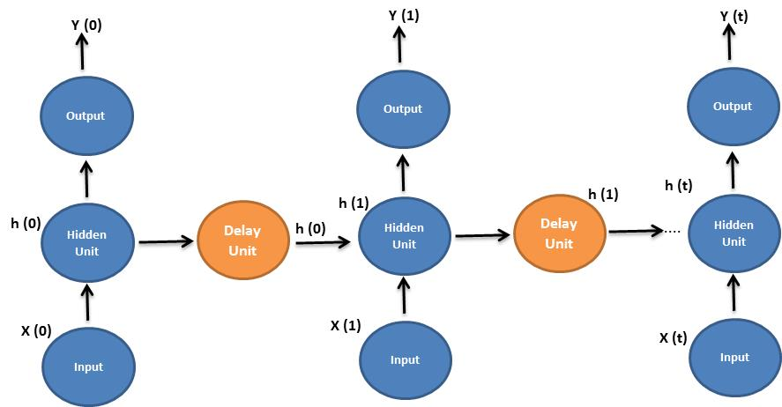
Schematic for RNN: Time Series Model - cont.
Backpropagation through Time -RNN
Backpropagation Through Time (BPTT):
The back-propagation-through-time (BPTT) algorithm for training a recurrent network is an extension of the standard back-propagation algorithm. It may be derived by unfolding the temporal operation of the network into a layered feedforward network,the topology of which grows by one layer at every time-step. To be specific, let N denote a recurrent network required to learn a temporal task, starting from time n0 all the way up to time n. Let N* denote the feed forward network that results from unfolding the temporal operation of the recurrent network N. The unfolded network N* is related to the original network as follows:
For each time-step in the interval [n0, n], the network N* has a layer containing K neurons, where K is the number of neurons contained in the network N.
In every layer of the network N*, there is a copy of each neuron in the network N.
For each time-step l E[n0, n], the synaptic connection from neuron i in layer l to neuron j in layer l + 1 of the network N* is a copy of the synaptic connection from neuron i to neuron j in the network N.
The basic idea is to unfold the RNN through time. This sounds complicated , but the concept is quite simple.
The figure illustrates the unfolded version of the previous figure. By unfolding , we simply mean that we write out the network for the complete time steps under consideration. Unfolding simple unrolls the recurrent loop over time to reveal a feed forward neural network. The unfolded neural network is essentially a deep neural network where each layer corresponds to a time step in the original RNN.
The resultant Feed-Forward Network can be trained using the backpropagation algorithm. Computing the derivatives of error with respect to weights is reduced to computing the derivatives in each layer of a feed forward network. Once the network is trained , the FF network “folds” itself obtaining the original RNN.
The “Delay” (also called recurrent or context) weights in the RNN are the sum of the equivalent connections weights on each fold
Fidelity Confidential

Slide 14
Overview- STL (Seasonal and Trend Decomposition using LOESS)

Slide 15
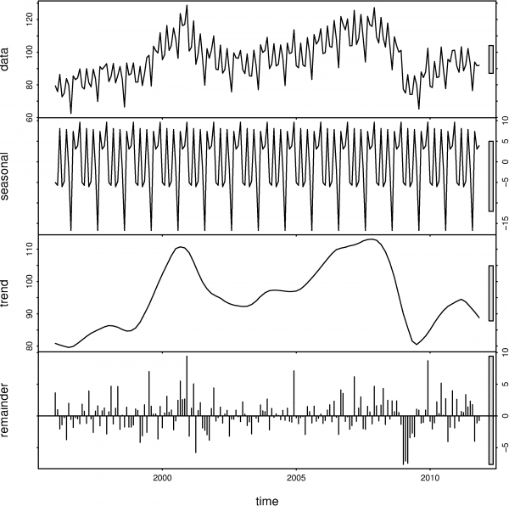
Overview -STL (Seasonal and Trend Decomposition using LOESS)
STL –( Seasonal and Trend Decomposition using LOESS)
STL Overview:
STL is a filtering procedure for decomposing a time series into trend, seasonal and remainder components. STL has a simple design that consist of a sequence of applications of the LOESS smoother. STL is a very versatile and robust method for decomposing time series. STL is an acronym for “Seasonal and Trend decomposition using Loess”, while Loess is a method for estimating nonlinear relationships. The STL method was developed by Cleveland et al. (1990).
STL has several advantages over the classical decomposition method and X-12-ARIMA:
Unlike X-12-ARIMA, STL will handle any type of seasonality, not only monthly and quarterly data.
The seasonal component is allowed to change over time, and the rate of change can be controlled by the user.
The smoothness of the trend-cycle can also be controlled by the user.
It can be robust to outliers (i.e., the user can specify a robust decomposition). So occasional unusual observations will not affect the estimates of the trend-cycle and seasonal components. They will, however, affect the remainder component.
On the other hand, STL has some disadvantages. In particular, it does not automatically handle trading day or calendar variation, and it only provides facilities for additive decompositions. (“PROPHET” as developed by FB is a GAM based decomposition model)
It is possible to obtain a multiplicative decomposition by first taking logs of the data, and then back-transforming the components. Decompositions some way between additive and multiplicative can be obtained using a Box-Cox transformation of the data with 0<λ<1. A value of λ=0 corresponds to the multiplicative decomposition while λ=1is equivalent to an additive decomposition.
STL Methodology:
Deseasonalize the series using STL decomposition
Fit an ARIMA model to the Deseasonalized Time Series.
Make forecast using ARIMA model.
Forecast the seasonal component from the STL decomposition using a Seasonal Naïve Forecast.
Add the ARIMA model’s forecast of the deseasonalized series to the seasonal naïve forecast of the Seasonal component to arrive at the Final forecast.
Fidelity Confidential

Slide 16
Appendix
References:
SVM Regression:
http://www.svms.org/regression/MSRS00.pdf
http://trace.tennessee.edu/cgi/viewcontent.cgi?article=3107&context=utk_gradthes
RNN / ANN
http://www.ijcaonline.org/archives/volume143/number11/zaytar-2016-ijca-910497.pdf
https://www.cs.cmu.edu/afs/cs/academic/class/15782-f06/slides/timeseries.pdf
https://www.otexts.org/fpp/9/3
STL / PROPHET - FB:
http://www.wessa.net/download/stl.pdf
http://www.sciencedirect.com/science/article/pii/S0169207011000070
https://www.otexts.org/fpp/6/5
https://facebookincubator.github.io/prophet/static/prophet_paper_20170113.pdf
Codes and Model Comparison summary doc:
https://github.com/shovon-Machine-Learning-DL-AI/Code---Time-Series-Machine-Learning

